Slide 1
University of El Oued

Slide 2
The name "oued" means in Arabic watercourse in the arid regions of the Maghreb. Whereas the term "Souf" is its equivalent in Berber, and also means "river".

Slide 3
Algiers
645 km
Location
Located in the south-east of the Algeria, along the Tunisian border on an average width of 160 km.
About 645 km away from the capital ( Algiers)

Slide 4
Architecture
The traditional and typical architecture of the region, characterized by domes on top of houses and buildings, has delighted many travelers. Moreover, El-Oued, capital of the Souf, is nicknamed "the city of a thousand and one domes".

Slide 5
Culture & Agriculture
El-Oued has its special type of music and songs, it has also a special traditional clothing.
Oued Souf Oasis has a particularity: its origin is artificial, man-made, and its cultivated lands are in the middle of the desert.

Slide 6
Agriculture
Agriculture specialized in date palms and vegetables (as potatoes) is typical from this site. People in El- Oued Souf practice a particular style of agriculture. This style of farming produces "Ghitanes" or palm fields of souf, where the palms are planted directly on the water, with the roots into the deep underground, in spots that are protected of the dunes, called "ghots"

Slide 7
Echahid Hamma Lakhdar

Slide 8
Echahid Hamma Lakhdar University (El-Oued ) has undergone five phases of development since 1995 .It reached more than 27,000 students , more than 800 professors and more than 600 employees divided across seven faculties and Institute of Islamic Sciences.

Slide 9
FACULTIES and subfields
Faculty of Technology
Electrical Engineering
Mechanics
Hydraulics
Telecommunications
Process Engineering
civil engineering
Faculty Of Nature & Life Sciences
Biochemistry
Toxicology
Physiology and Biology of Plant
Ecology and Environment
Agriculture

Slide 10
Faculty Of Economics , Trade Sciences and
Management
Stock Management
International Trade
Marketing
Finance and Banks
Business Management
Management of Human resources
Accounting and Taxes
Faculty of Social Science And Humanities
Educational Sociology
Sociology of Communication
Environmental Sociology
Guidance & Counseling
Sociology of Work and Organization
General Philosophy
General History

Slide 11
Faculty of Exact sciences
Mathematics
Physics
Chemistry
Computer Sciences
Faculty of Arts And Languages
Arabic Language
French Language
English Language
Faculty Of Law and Political Sciences
General Law
Special Law
Political Organizations
International Relations

Slide 12
Faculty Of Islamic Sciences
Sharia and Law
Dawah and Islamic culture
Hadith and Its Sciences
Quran and Tafsir
Comparative Religion

Slide 13
Education and Training
838
Academic staff
Administrative Staff
687

Slide 14
Statistics
Faculties | Number of students
Faculty of Social Science And Humanities | 4388
Faculty of Arts And Languages | 4140
Faculty of Technology | 4523
Faculty Of Economics , Trade Sciences and Management | 3739
Faculty of Exact sciences | 2079
Faculty Of Islamic Sciences | 1974
Faculty Of Nature & Life Sciences | 3113
Faculty Of Law and Political sciences | 2234

Slide 15
Scientific research
PhD programs : 56 specialties
Laboratories
Renewable energy
Chemistry
Physics
Environment
Electrical engineering
Economy
Social sciences and humanities
Laws
Arabic literature
Algerian literature
The integration of knowledge between Arabic and social sciences

Slide 16
15 international and national conferences
Scientific Events in 2019

Slide 17
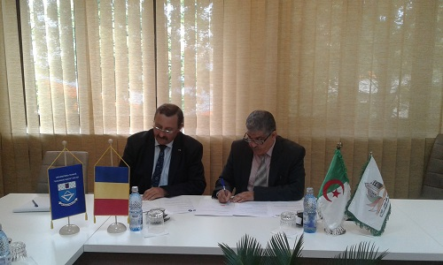
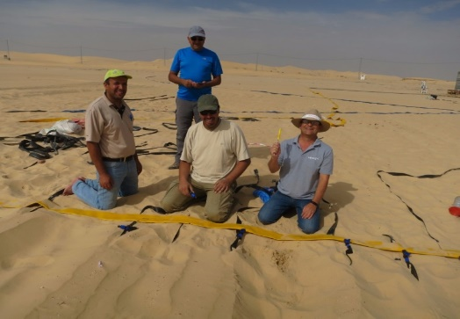
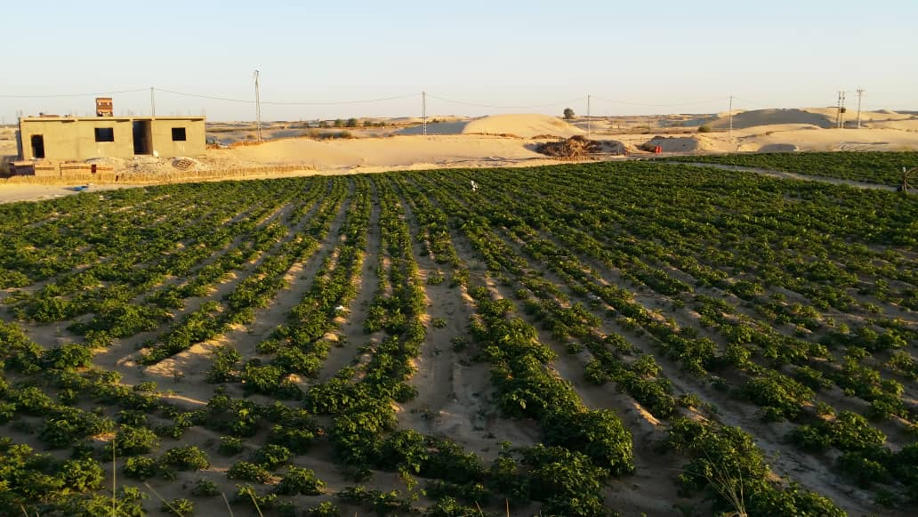
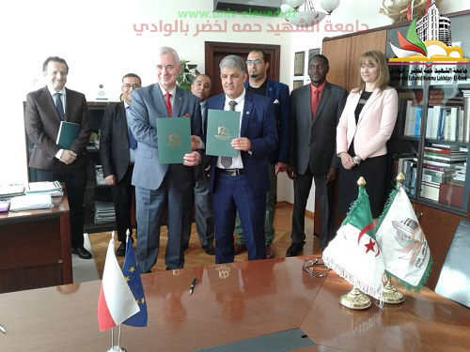
More than 60 international agreements
External Relations
international projects with :
PRIMA : Kamel-Milk Project
ESAGOV: Gouvernance ( CBHE )
Wageningen University & Research : Sustainable water use for potato production in El Oued, Algeria
IDEA: L’Internationalisation à Domicile En Algérie
AARMENA : ( CBHE )

Slide 18
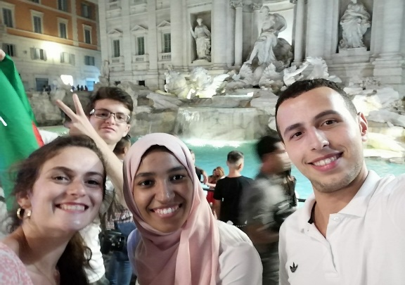
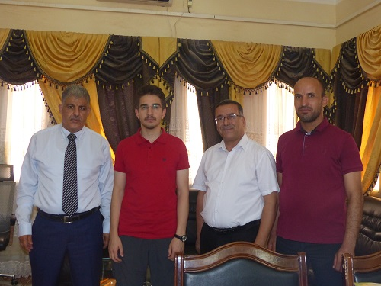
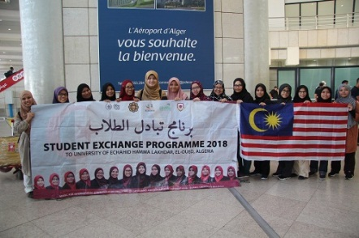
INTERNATIONAL EXCHANGE PROGRAMS
Erasmus+ exchange programs with several european universities such as :
UNIVERSITY OF NOVI PAZAR – SERBIA
UNIVERSITY OF GHEORGHE ASASHI – ROMANIA
HELLENIC MEDITERRANEAN UNIVERSITY– GREECE
UNIVERSITY OF SAPIENZA – ITALY
UNIVERSITY OF ANADOLU – TURKEY
NICOLAUS COPERNICUS – POLAND
Riga Technical University- LATVIA
More than 20 grants between students, academic and administrative staff under Erasmus + exchange programme ICM
Mevlana exchange programs with Turkish Universities such as: UNIVERSITY OF ANADOLU, University of Konya, University of Firat, University of Akdeniz….etc.

Slide 19
Students activities
8 scientific and cultural
2 sports clubs
With many events/demonstrations each year

Slide 20
Student's residence and transportation
5 students residence devided as following :
3 student residence for females and 2 for males Equipped ( restaurants, stadiums, health care centers, cafeterias, theatres
….etc

Slide 21
Thank You for watching

