Slide 1
INJAZ Profile
September 2023

Slide 3
Key Milestones
1999-2004
2005-2011
2012-2018
2019-2023
Launch
Sustain
Scaleup
Expand
Founded as an Independent Non-profit Organization
Introduced Financial & Entrepreneurial Competencies as Extra-curricula Programs
Introduced Soft Skills and Career Guidance within the Education System
Connected Private Sector Professionals with Academia
Built Institutional Capacity and established the Board of Trustees
Scaled-up in 250+ Public Schools across Jordan
Launched New, High Impact Programs
Boosted the Culture of Volunteerism
Launched Employment Program
Mainstreamed Financial and Entrepreneurship Education within the National Curricula (Grades 7-12)
Established mySTARTUP Business Incubator, with focus on Idea & Early Stage
Launched Digital Skills in Schools and Universities
Focused on Inclusivity and Social and Environmental Impact
Established International Partnerships for Regional Expansion
Launched Online and Ed-tech Educational Programs
Introduced Blended Learning Approach
Contributed to the Advancement of the Entrepreneurship Ecosystem in Jordan

Slide 4
Thematic Areas and Lenses
Financial Literacy
Entrepreneurship
& Business Skills
Digital
Competencies
Interpersonal Skills
Thematic Areas
Lenses
Employability
Gender
Social Participation
Employability
Gender
Ethical Values

Slide 5
Programs
Schools
Curricular
Extra-curricular
Tailored Activities
Teachers Training
Projects & Competitions
Universities, Colleges, TVET
Accredited Courses
Extra-curricular
Tailored Activities
Projects & Competitions
Incubation
Ideation & Growth
Mentorship & Coaching
Access to Markets
Access to Finance
Sector-agnostic & Verticals
Employment
Training and Job Matching
Internship
Fellowship
Women's Workforce Participation
National Financial Inclusion
National Financial Education
Financial Sector Workforce
Financial Sector Clients
Marginalized Communities

Slide 6
Outreach – Theory of Change
Startups & Job Creation
mySTARTUP
[Launched in 2018]
Employment & Entrepreneurship Programs in Higher Education
[Launched in 2005]
Idea and Early-stage Startups
Sustained, Growing Businesses
Education Programs in Schools (G7-12) [Launched in 2000]
[Mainstreamed in 2015]
70 startups/year
20 businesses/year
Age 20 - 30
5,000 students/year
Age 18 - 24
850,000 students/year
Age 12 - 18
A S t u d e n t ‘ s E n t r e p r e n e u r s h i p J o u r n e y
DISCOVER
EXPLORE
VALIDATE
BUILD
LAUNCH
GROW

Slide 7
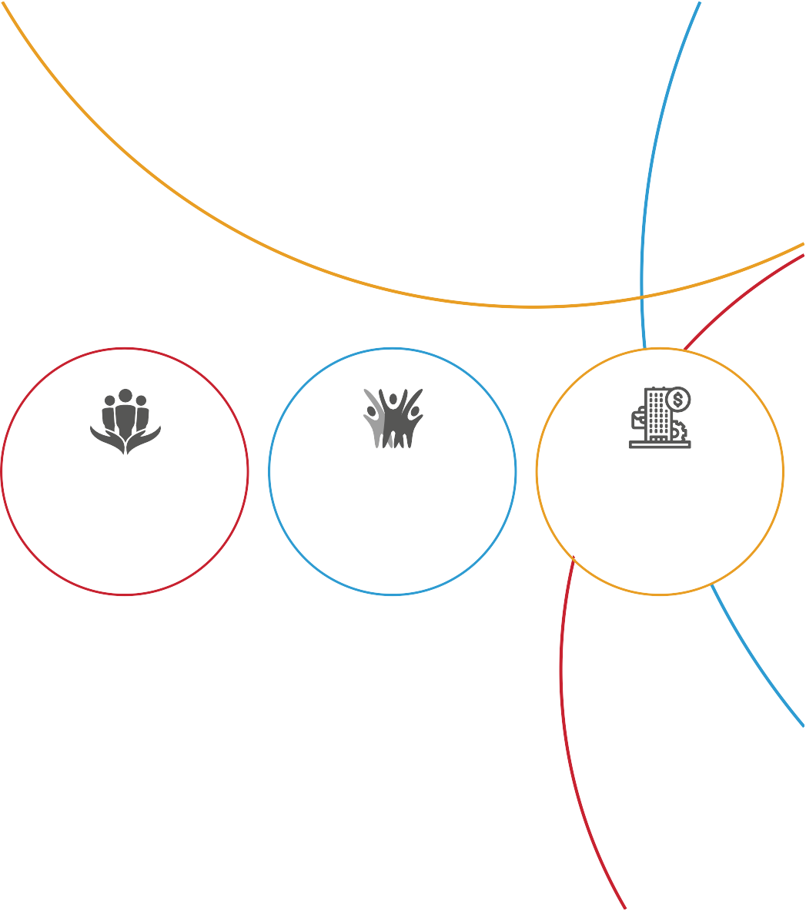
Outreach – Executing Partners
Schools
3,851
Universities
30
Colleges
16
Social Dev. Centers
10
Youth Centers
40
TEVET Institutions
23

Slide 8
Outreach – Online (INJAZ)
Number of Followers (Aug 2023):
254,000
Number of Followers (Aug 2023):
114,300
Number of Followers (Aug 2023):
44,072
Number of Followers (Aug 2023):
9,708

Slide 9
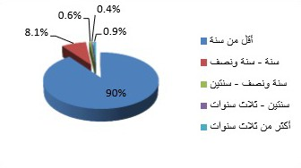
Impact on Youth Employment
90 % of INJAZ students are employed within the first year after graduation (vs. 30 % who are not part of INJAZ programs)
توزيع المشاركين الذين حصوا على وظيفة حسب المدة الزمنية التي آمضوها بعد التخرج في البحث عن وظيفة

Slide 10
Impact on Startups Growth
Startups Incubated
328
Revenue Generated
$2.3 million
Investment Raised
$2.4 million
Jobs Created
1,500+

Slide 11
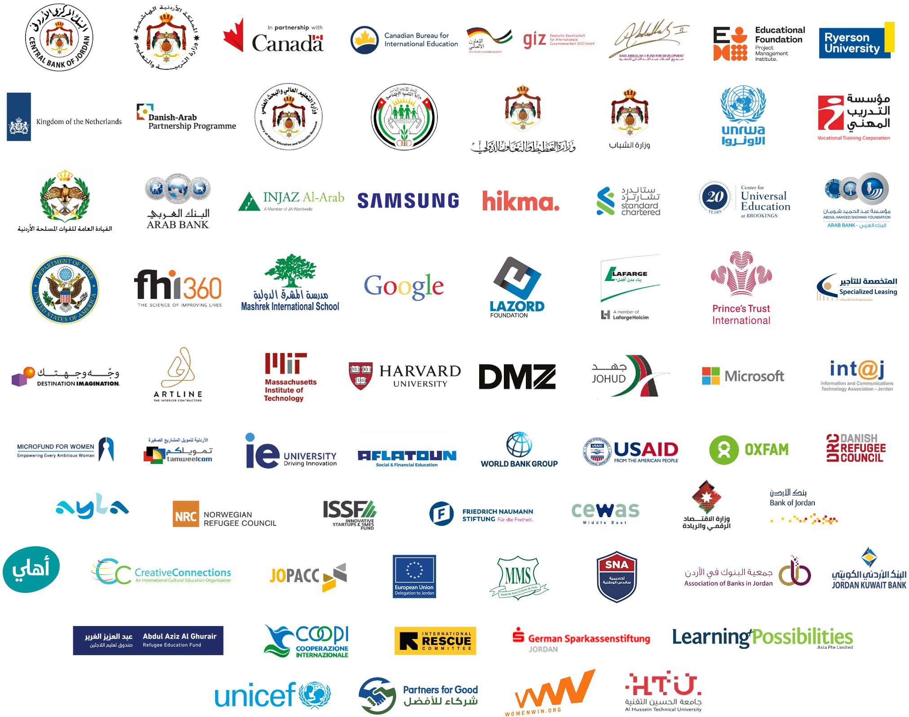
Partners Network

Slide 12
Board of Trustees 2023

Slide 13
Thank You

